Slide 1
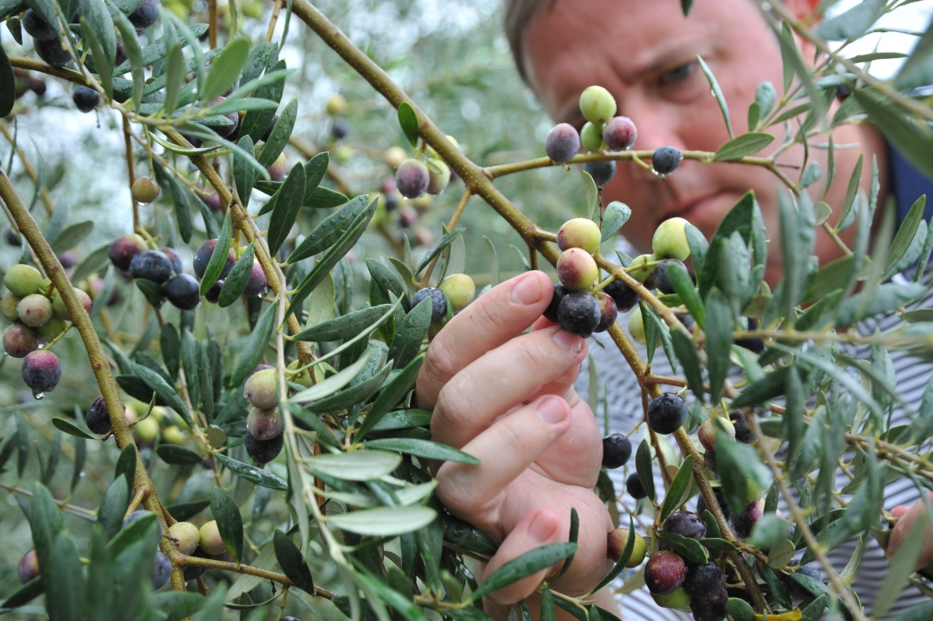
Welcome

Slide 2


Update

Slide 3
Resource Panel
Donnie Smith, —Georgia Center of Innovation for Agriculture
Bruce Green—Georgia Department of Economic Development
Rhonda Geiger—Georgia Department of Economic Development
Paul Thompson—Georgia Department of Agriculture
Jason Deal—Georgia Department of Agriculture
Ruby Riesinger—Valdosta State University SBDC
Bill Boone—University of Georgia SBDC
Stan Moore—USDA/NRCS

Slide 4
Grower Panel
Kevin Shaw—Georgia Olive Farms & Gayla’s Grits
Don Mueller—Green Gate Olive Grove
Sam Shaw—Georgia Olive Tree Nursery & Farming
Paul Miller—Extra Virgin Alliance
Bob Krueger—Krueger Family Farms
Berrien Sutton—Still Pond Farms & Georgia Olive Farms

Slide 5
Traditional Orchard Planting and Southeast Olive Production
Don Mueller
Green Gate Olive Grove
Panama City, FL

Slide 6
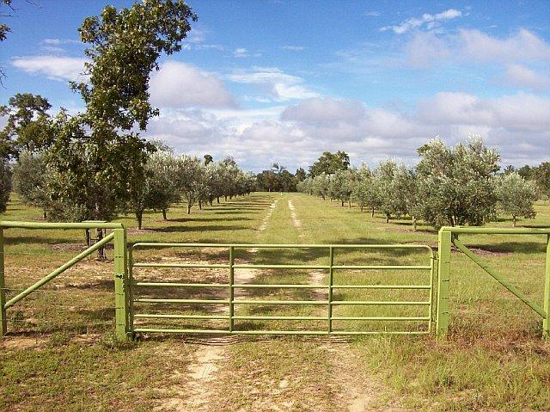

Slide 7


Slide 8
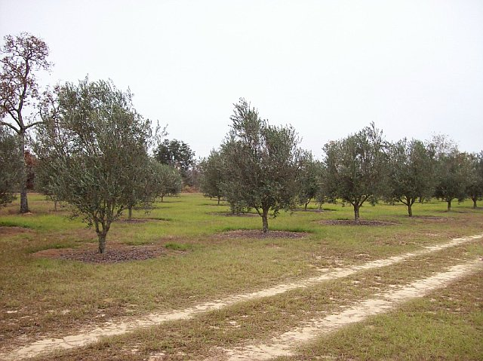

Slide 9
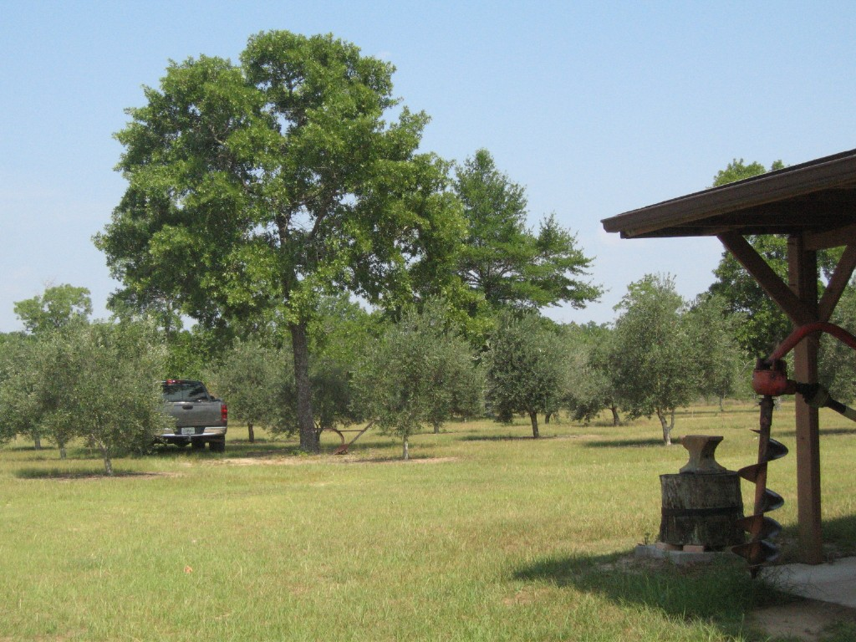

Slide 10
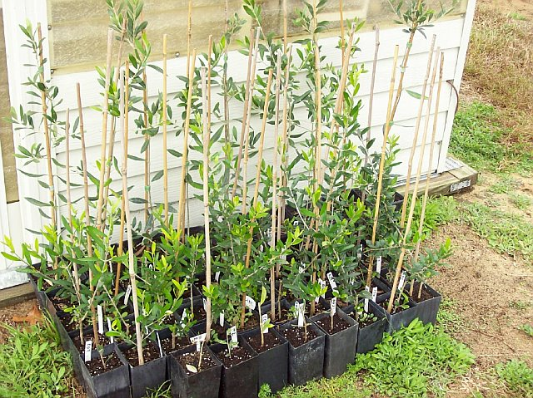

Slide 11
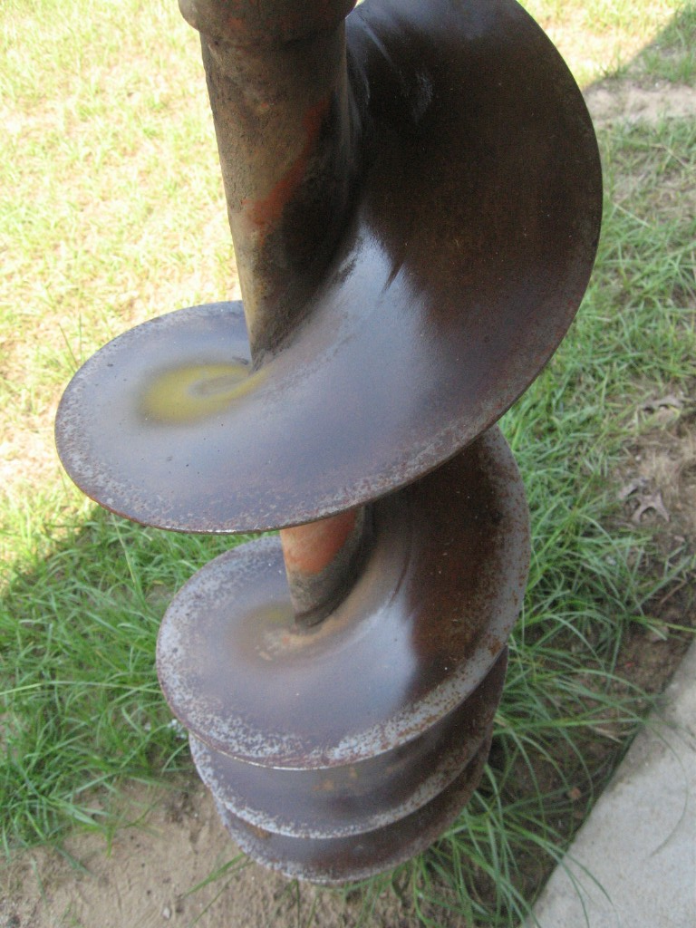

Slide 12
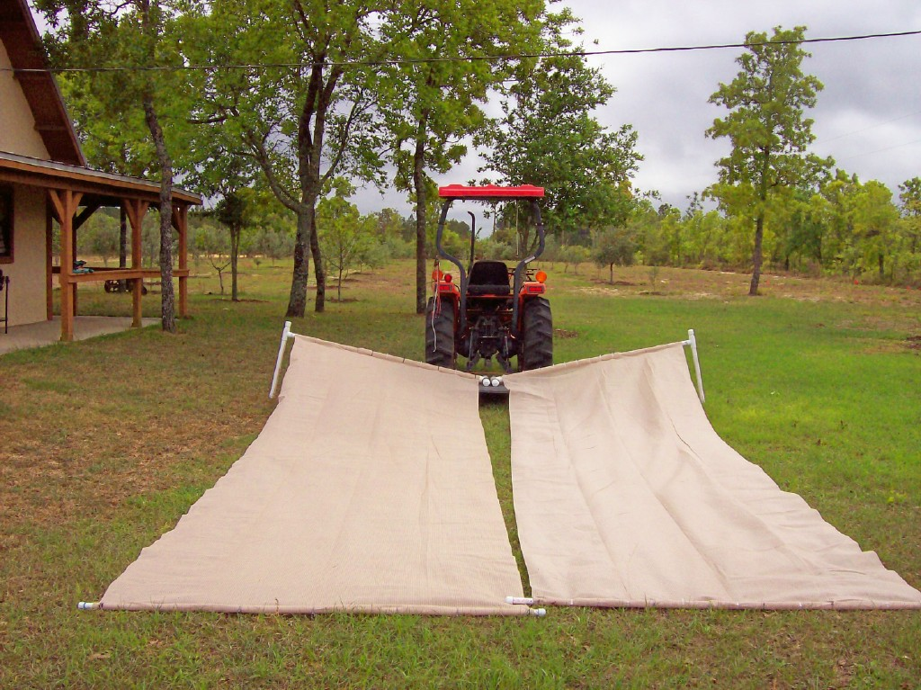

Slide 13
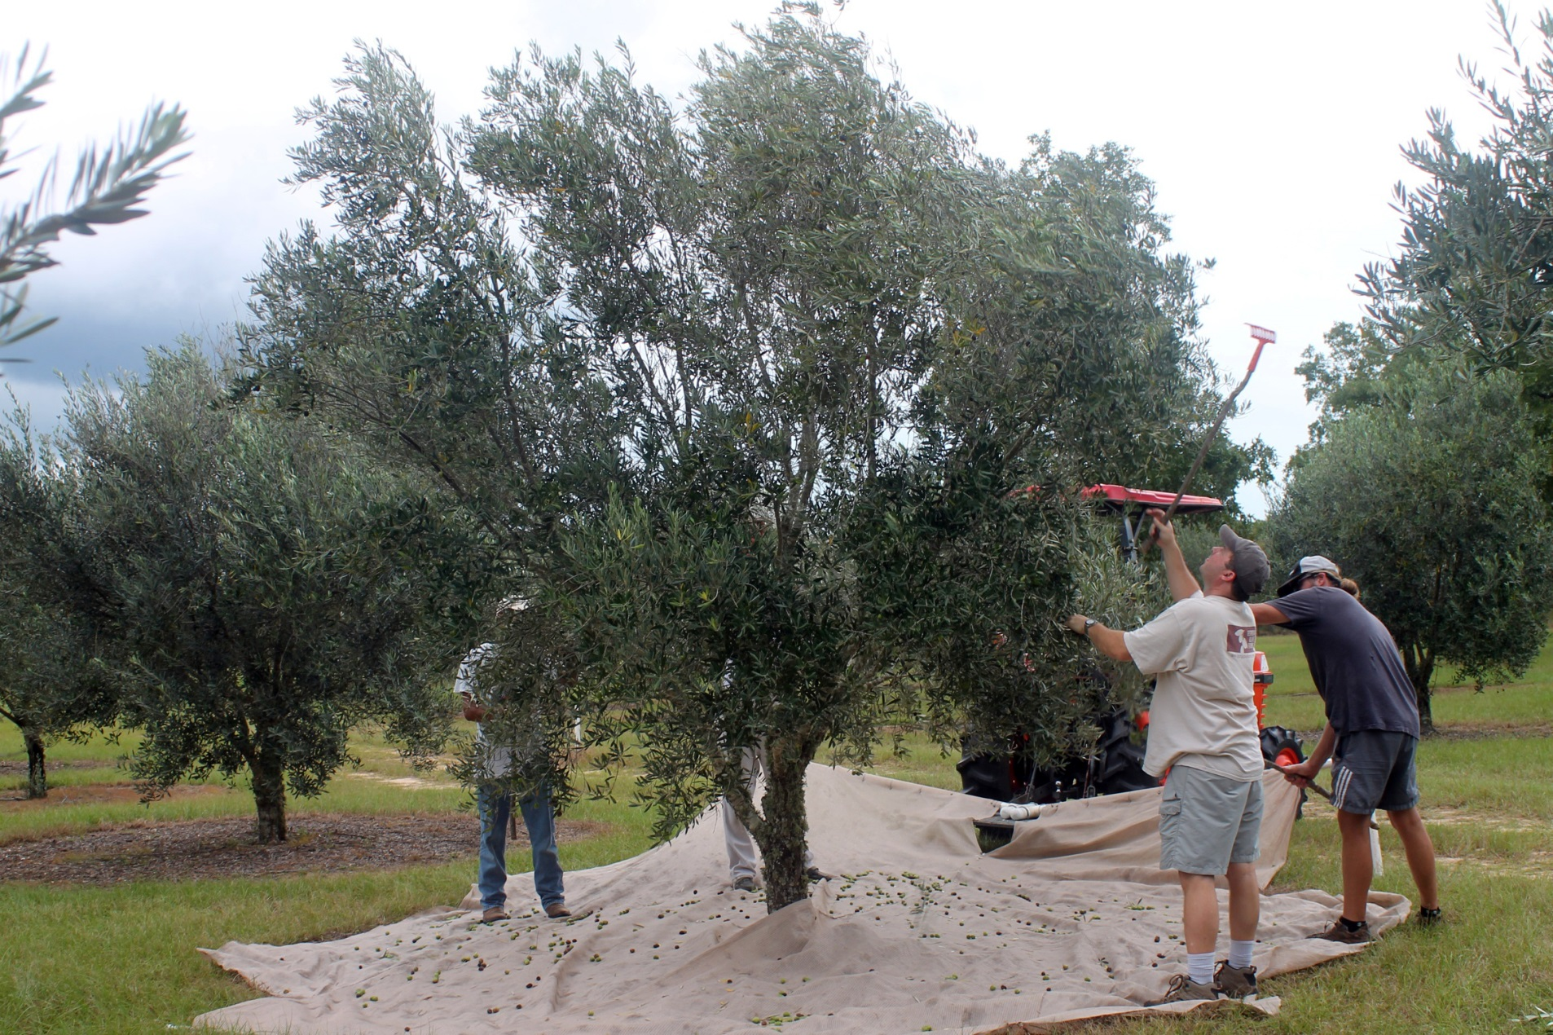

Slide 14
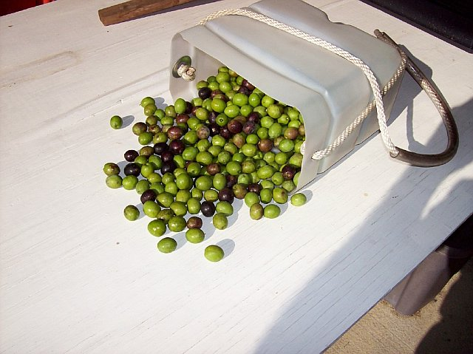

Slide 15
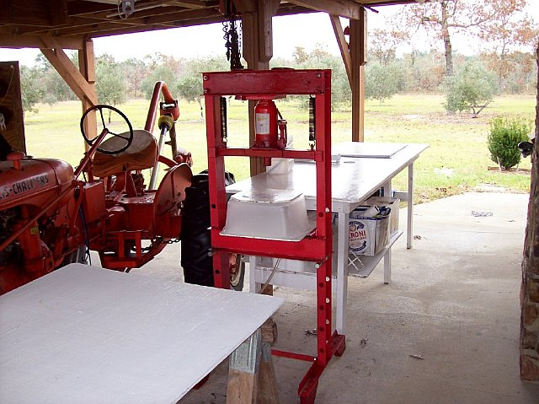

Slide 16
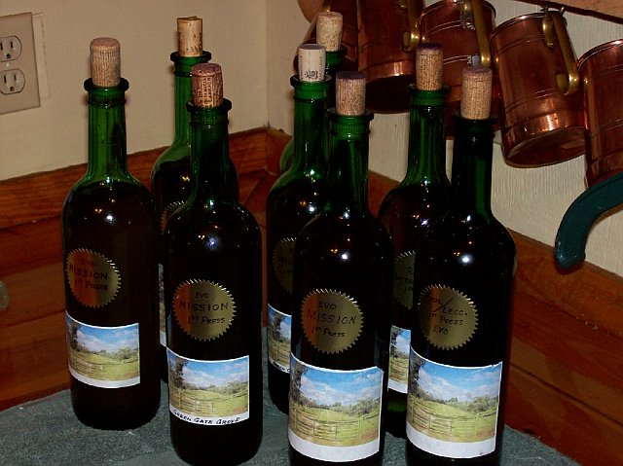

Slide 17
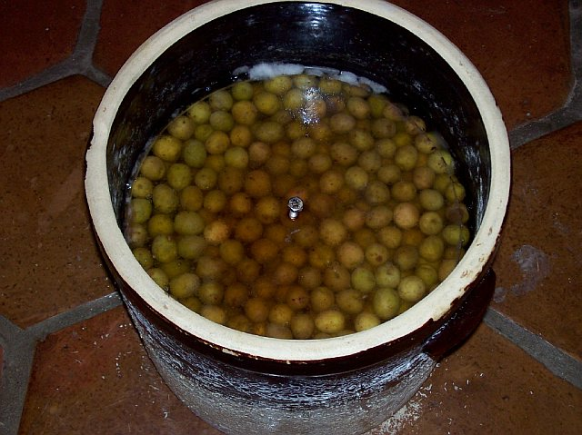

Slide 18
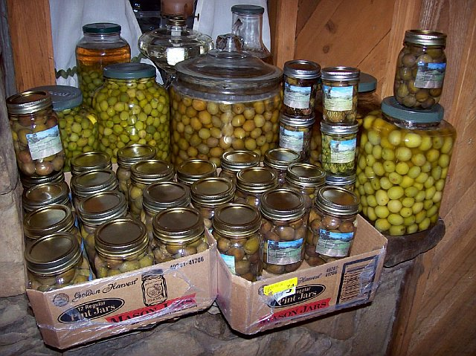

Slide 19
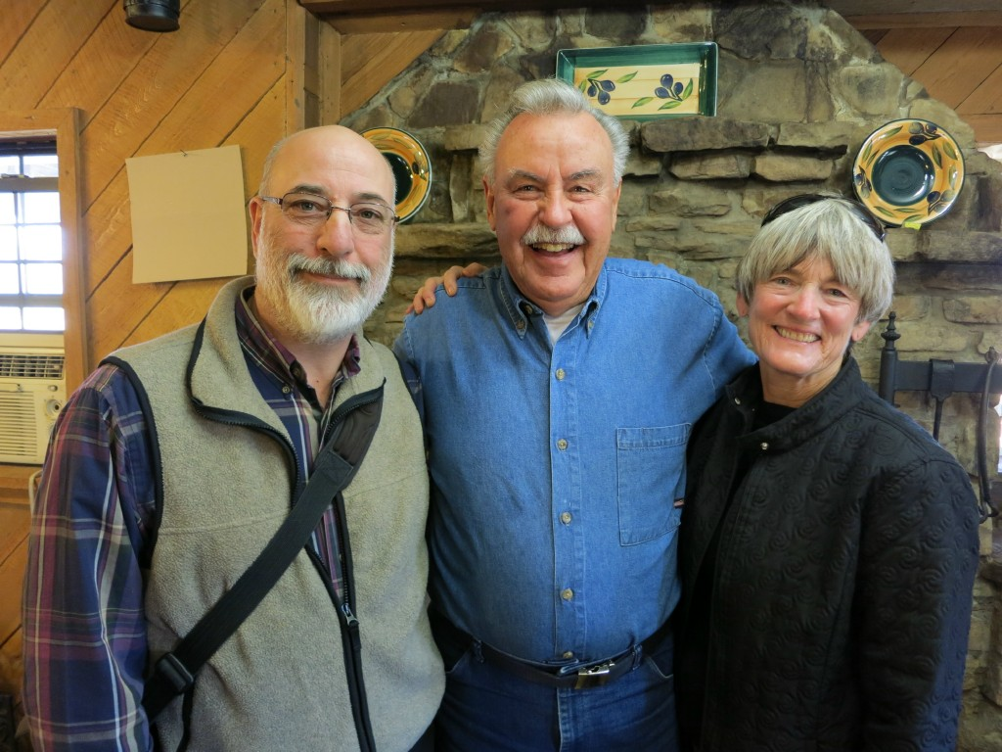

Slide 20
Thank you!
Don Mueller
Green Gate Olive Grove
Panama City, FL
(850) 763-6355
info@greengateolivegrove.com
www.greengateolivegrove.com

Slide 21
Networking Break and
Exhibits
Sponsored by
Georgia Department of Economic Development

Slide 22

Keynote Speaker
Kimberly Houlding
Director of Government and Industry Relations American Olive Oil Producers Association (AOOPA)

Slide 23
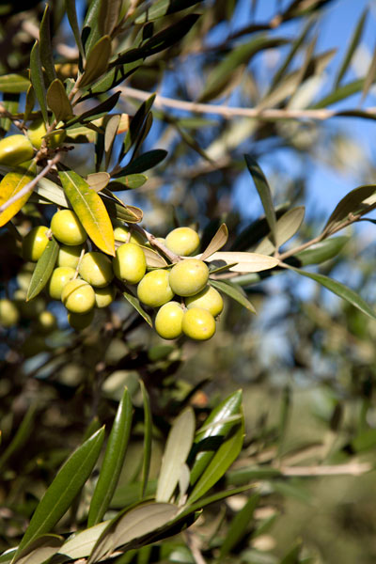
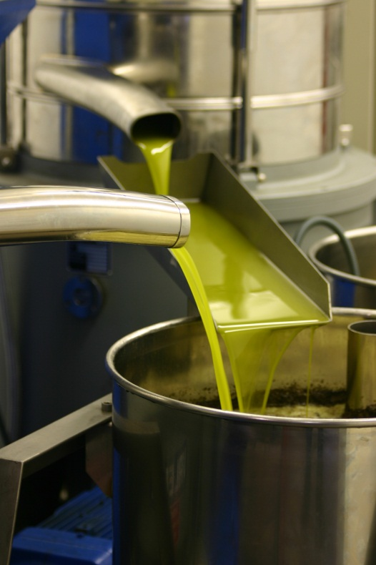
The Future of the Domestic Olive Oil Industry
By
Kimberly Houlding
American Olive Oil Producers Association

Slide 24
U.S. OLIVE OIL INDUSTRY
California | Texas | Georgia | Florida
More than 30,000 planted acres Acreage expected to expand 10% annually Approximately 40 mills 2.5m gallons of olive oil produced | Approximately 2,500 planted acres Acreage expected to double next 12 months 4 mills with a new mill planned to be developed in 2014 | More than 250 planted acres Acreage expected to double in the next 12 months Produced the first EVOO on the east coast in over 100 years in 2011 New commercial mill and storage facility under construction | Approximately 100 planted acres Additional acreage expansion anticipated
Additional Olive Oil Production
Arizona has more than 1,800 acres of olive trees for oil production and a milling facility
Maui has several 1,000 trees planted and has 50-75 growers
There is limited plantings on Oahu
Maui’s first milling facility is being developed this year
University of Hawaii is conducting crop trials at their research station

Slide 25
MARKET OUTLOOK
Poor Crop in Spain – 30% drop in the global production for 2012/2013
Global prices for current crop EVOO increased from $9 to $14 in the past 9 months
Anticipated industry retail price increases of 10-20%
Olive Oil Consumption:
Down in Spain 14%
In USA up 9% in the last year

Slide 26
ISSUES
China Scrutinizes Olive Oil Imports from Italy
January 07 2012 | Filed in: Asia
By Vikas Vij lOlive Oil Times Contributor
Nineteen Arrested Over Alleged Olive Oil Fraud
Posted on February 10 2012 | Categorized in: European Union
By Julie Butler
Olive Oil Times Contributor | Reporting from Barcelona
Spanish police this week arrested 19 people allegedly linked to a complex network engaged in multi-million euro olive oil fraud, money laundering and tax evasion.
According to Diaro Jaén, the police – who swooped on Wednesday after a year-long probe by a Madrid-based economic crime unit – believe that companies involved in the ‘ring’ had been selling other, lower quality vegetable oils as extra virgin.
New Book Accuses Council of Holding Olive Oil to ‘Lowest Denominator’
Posted on November 20 2011 | Categorized in: Olive Oil World
By Curtis Cord, Olive Oil Times Executive Editor
In the new book, Extra Virginity: The Sublime and Scandalous World of Olive Oil, there’s plenty of blame to go around for the “widespread dumbing down of olive oil quality,” but author Tom Mueller reserves perhaps his most direct castigation for the International Olive Council.
Spanish Consumer Group Finds Nearly One in Three Olive Oils Mislabeled
October 26 2012 | Filed in: European Union
by Julie Butler
A Spanish consumer body says nine out of 34 extra virgin olive oils it tested were really virgin olive oil and one was lampante.
Olive Regions Work on Joint Strategy to Maintain EU Subsidies
April 02 2012 | Filed in: European Union
by Julie Butler
A new olive oil lobby group is urgently preparing a position paper to protect its members from threatened subsidy cuts by the European Commission.

Slide 27
THREE MAIN ISSUES
Quality Issues
Tariffs
Subsidies
Notes:
Quality: Olive Oil Fraud: 1) UC Davis Studies 2) Consumer Report 3) Spain Crack Down 4) China
Tariffs: 3000% Tariff our product going into the EU; Effectively 63% of the World’s Consumption is off limits (EU)
Subsidies: 70% of the world’s production (EU) receives subsidies; nearly 40% of their production value; $1.3 B

Slide 28
WITHIN THE THREE ARE MORE
Federal Marketing Order
International Standards
National Standard
State Standards
Good Science
Enforcement
Import Provision
International Trade Barriers
USITC Investigation
Research Funding
Just to name a few…

Slide 29
Federal Marketing Order
FACTS: There is no drafted marketing order
IF industry moves forward 18 – 24 month process (lots of hearings)
IF USDA says should move forward then a vote of the industry
Renewed every 5 – 6 years
Order is a government entity with oversight by USDA
Activities may include: marketing/promotion; research; grades and standards

Slide 30
OTHERS VERY ORGANIZED
Europeans
Hired top lobbyist
Already met with USDA, Senators, Congressional members and staff.
Australia Standards Established
South Africa Looking at Adopting Similar Standards
U.S. Producers Had No Voice

Slide 31
INDUSTRY DECISIONS
What are we doing as an industry?
Accept European rules?
Organize and become part of the conversation?

Slide 32
AOOPA
Organization made up of U.S. olive oil producers
CA
FL
GA
TX
U.S. and International Issues
Organization to Provide Unified Voice
Already Produced Dramatic Results

Slide 33
ACCOMPLISHMENTS
Coordinated domestic producers and international allies for multiple aspects of USITC Investigation
Coordinated an Olive Oil Tasting on Capitol Hill: featured olive oil from California, Texas, Georgia and Florida
Discussed issues related to the competitiveness of the U.S. olive oil industry with key members of the Administration and Congress

Slide 34
SIGNIFICANT CHANGES BEGINNING
USITC Investigation
Import Provision (making an equal playing field)
Discussions Of International Trade Issues
Adding To The Debate
Increased Awareness Of The Issues

Slide 35
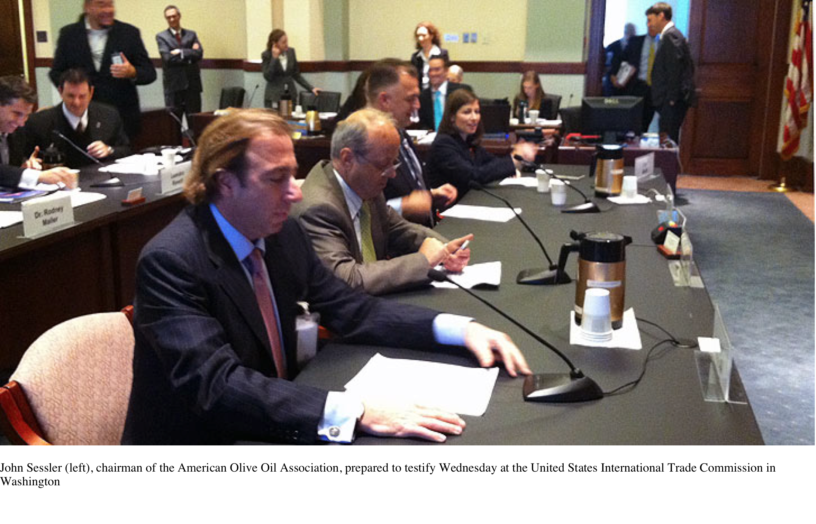
THE LATEST HEADLINES
Three Fronts Converging in U.S. Olive Oil Industry
Posted on December 03, 2012
by Nancy Flagg
Olive Oil Times Contributor | Reporting from Sacramento
Three fronts, and the opposition to them, underscore the growing strength and voice of the U.S. domestic olive oil industry.
Dr Oz: 65% of Olive Oil is Fake!
Dr. Oz is uncovering the biggest supermarket lies that you need to hear about! http://www.drozfans.com/dr-oz-food/dr-oz-fake-olive-oil-vs-cocaine-profits-dr-oz-olive-oil-purity-test/
Olive Oil Producers Seek ‘Level Playing Field’ in Global Market
The Los Angeles Times 2012-12-08: WASHINGTON — California olive oil producer Pat Ricchiuti feels the squeeze of foreign competition. So do his counterparts in Texas, Georgia and a handful of other states. Now, with the help of congressional allies, these leading U.S. olive oil producers are forcing a closer look at a tough global market. In a U.S. International Trade Commission hearing this week, officials ratcheted up a yearlong investigation that could end up pitting importers against domestic producers and one country against another. "We just want a level playing field so we can compete," said Ricchiuti, president of Enzo http://article.wn.com/view/2012/12/08/Olive_oil_producers_seek_level_playing_field_in_global_marke/#/related_news
USITC Holds Hearing on Olive Oil Market Conditions
Posted on December 06 2012 | Categorized in: Olive Oil World
By Curtis Cord
Olive Oil Times Executive Editor | New York
USITC Holds Hearing on Olive Oil Market Conditions | Olive Oil Times

Slide 36
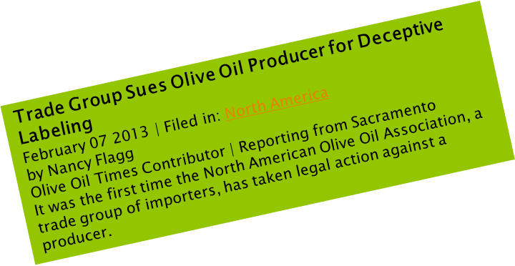
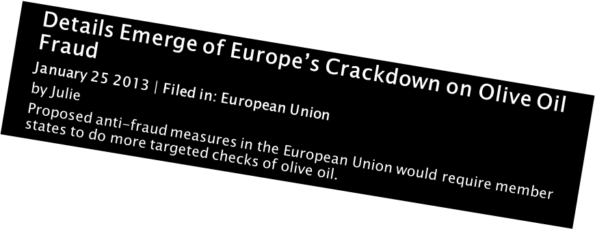
MORE HEADLINES
European Commission Asked to Act on Threat of U.S. ‘Trade Barriers’
by Julie Butler
Concerns have been raised in the European Parliament about potential harm for E.U. exporters from the proposed U.S. marketing order. http://www.oliveoiltimes.com/tag/olive-oil-standards
European Parliament Provides Some Comfort for Spanish Olive Oil
March 18 2013 | Filed in: European Union
by Julie Butler
Olive Oil Times Contributor | Reporting from Barcelona
A hatchet still hovers over subsidies paid to farmers, but the Parliament gave them some hope of easing the imminent blow.
http://www.oliveoiltimes.com/olive-oil-business/europe-provides-some-comfort-for-spanish-olive-oil/33402
South African Olive Oil Producers Seek Reforms
April 30 2013 | Filed in: Africa and The Middle East
by Omeros Demetriou
Olive Oil Times Contributor | Reporting from Cape Town, South Africa
A new chapter for South African olive oil is taking shape with several major developments promising reform for the local industry

Slide 37
THE “MO” FACTOR
Momentum Is Building Behind The Industry
U.S. Is Now Becoming Part Of the Discussion
Several Issues Still Coming
Putting Together Infrastructure
Have A Great Opportunity To Change The Industry
THE FIGHT IS EARLY AND IT HAS JUST BEGUN!

Slide 38
GOOD NEWS
Mediterranean Diet Shown to Ward Off Heart Attack and Stroke
By GINA KOLATA
Published: February 25, 2013
About 30 percent of heart attacks, strokes and deaths from heart disease can be prevented in people at high risk if they switch to a Mediterranean diet rich in olive oil, nuts, beans, fish, fruits and vegetables, and even drink wine with meals, a large and rigorous new study has found.
http://www.nytimes.com/2013/02/26/health/mediterranean-diet-can-cut-heart-disease-study-finds.html?pagewanted=all&_r=0
‘Space Laser’ Can Detect Fraudulent Olive Oil
by Naomi Tupper
Posted on February 17 2013
A new laser device developed to detect carbon on Mars, could be used detect food fakes, including fraudulent olive oil, here on earth. http://www.oliveoiltimes.com/olive-oil-basics/space-laser-detects-fraudulent-olive-oil/32854
Improved DNA Tracing Puts Olive Oil Adulterers on Notice
by Julie Butler
Spanish scientists claim they are close to offering‭ “‬paternity tests‭" ‬for virgin olive oil which would be a powerful ally against fraud
http://www.oliveoiltimes.com/olive-oil-business/improved-dna-tracing-puts-olive-oil-adulterers-on-notice/33881

Slide 39
2013 GOALS
Ongoing exploration of ways to level the playing field for domestic producers to compete with international producers
Continue to be a liaison between the U.S. olive oil industry and the world olive oil industry

Slide 40
NEED YOUR HELP
Need To Stay In The Fight
AOOPA
Asking all American producers to participate
Help keep fighting the good fight
Stay informed on all the latest developments
Be a resource and a voice for the American Olive Oil Industry

Slide 41

Alexander Ott
Executive Director
aott@aoopa.org
Kimberly Houlding
Director of Government and Industry Relations
khoulding@aoopa.org
(559) 472-7838

Slide 42


Legislative Update
Paul Miller
Jason Shaw
President, Australian Olive Association
Partner, Georgia Olive Farms

Slide 43
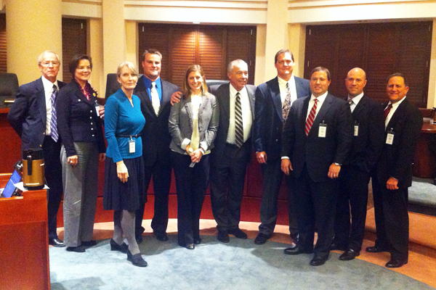
Washington Team

Slide 44

Featured Chef
Chef Dave Snyder
Owner/Executive Chef
Halyard Restaurant Group
St. Simons Island, Georgia

Slide 45
Presentation
In Recognition and Appreciation for his generous contributions and support of the olive industry in the Southeastern United States.
His Mentorship and Dedication has truly blessed us all.

Slide 46
In Closing
Door Prize Drawing
Lunch
Short Growers Member Meeting
Farm Tour and Store Visit

